Slide 1



NAVIGATION
-F/C HARIHARAN
-F/C TEJASWI

Slide 2
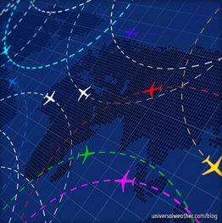
TOPICS
REQUIREMENTS OF NAV (NV-1)
GLOSSARY OF TERMS (NV-2)
MAPS (NV-3)
MAP READING (NV-4)

Slide 3
REQUIREMENTS OF NAVIGATION(NV–1)
WHAT IS NAVIGATION..?
Finding a way from one place to another or following a route.
AIR NAVIGATION -
Air Navigation is the art of guiding an aircraft through the air, so that it arrives at a desired position at a pre-calculated time.
Air Navigation differs from surface navigation in several ways such as the aircraft travels at relatively high speeds, leaving less time to calculate their position enroute.
Aircraft also normally cannot stop in midair to ascertain their position at will.

Slide 4
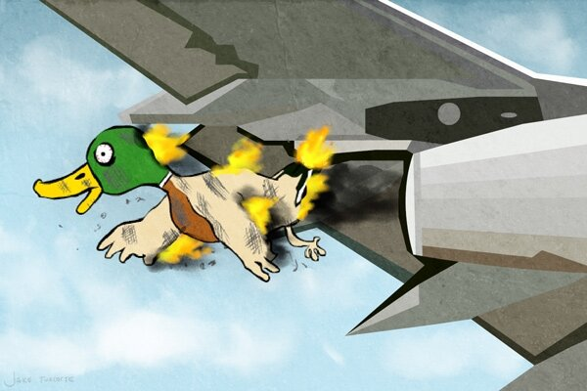

WHY NAVIGATION..?
Aircraft are safety-limited by the amount of fuel they can carry, a surface vehicle can usually get lost, run out of fuel, then simply await rescue. There is no in-flight rescue for most aircraft.
Additionally, collisions with obstructions are usually fatal. Therefore, constant awareness of position is critical for aircraft pilots.

Slide 5


A number of times Pilot may be called upon to navigate the aircraft himself especially in the aircraft types where no navigation is provided or in a single seat aircraft, hence a thorough knowledge of the art of navigation is a must for a pilot.
Since the pilot has the primary duty of flying the aircraft, it would not be possible for him to carry out the detailed task of a professional navigator in usage of plotting tables, computers, charts etc. He however has to be skilled in map reading and mental DR in order to navigate accurately.

Slide 6
HOW..?
Techniques used for air navigation in the air can be broadly classified into two groups.
(a) Visual Flight rules(VFR)
(b) Instrument Flight Rules (IFR).

Slide 7
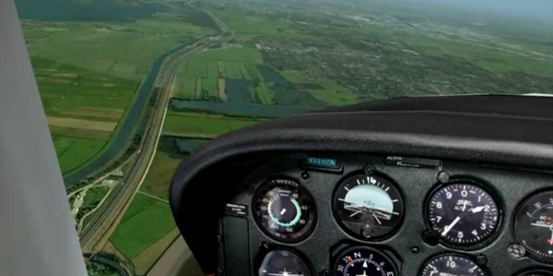
VISUAL FLIGHT RULES:
In aviation, visual flight rules (VFR) are a set of regulations under which a pilot operates an aircraft in weather conditions generally clear enough to allow the pilot to see where the aircraft is going.
The Pilot largely navigates using dead reckoning combined with visual references.
Pilot will use the appropriate
maps for references too.
Supplemented by radio
navigation

Slide 8
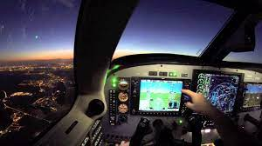
Instrument Flight Rules (IFR):
Under these rules pilot navigates using instruments.
Navigates using nav aids.
Nav Aids:
Beacons
RADAR

Slide 9
Instrument Flight Rules (IFR):
Before the flight the pilot must take pains to prepare and plan the flight meticulously.
For planning he will have to refer to the correct scale of maps, take forecast winds into consideration, plan the cruising altitude, calculate ground speed and time of flight and quantity of fuel required.

Slide 10
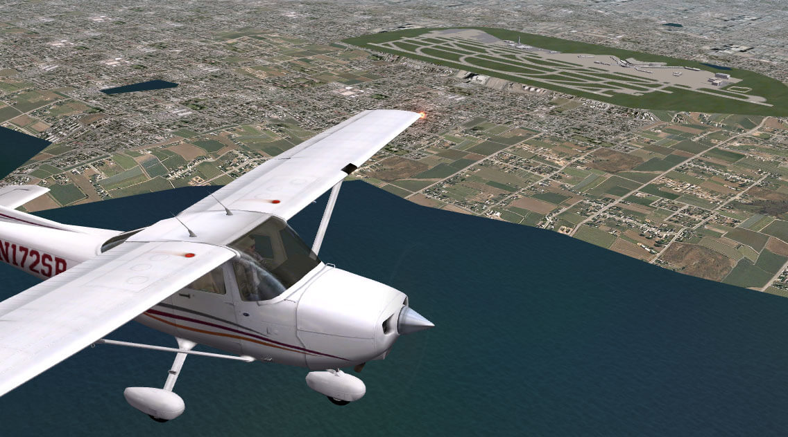

He also would require to study the various nav aids available at the departure, alternate and destination aerodromes, enroute check points, their frequencies, time of availability etc.
Once in flight the pilot must stick to the plan otherwise getting lost is all too easy.
This is especially true if flying over featureless terrain or flying in the dark.
This means that the pilot must stick to the calculated headings, heights and speeds as accurately as possible.

Slide 11
IMPORTANCE IN AVIATION:
Apart from map reading and mental DR (mental dead – reckoning) the pilot navigator should also be able to fly the aircraft accurately.
Variation in speed, heights and directions often results in unexpected gross errors and place the aircraft quite far away from the desired track and time.
A good pilot will plan a good flight meticulously and fly that good plan.
Successful air navigation involves piloting an aircraft from place to place without getting lost, breaking the laws applying to aircraft or endangering the safety of those on board or on ground.
CONCLUSION:
Air Navigation is an important aspect of aviation and learning the skills involved in good navigation techniques is an important aspect of flight training.

Slide 12
GLOSSARY OF TERMS (NV-2)
The earth is an oblate spheroid whose polar diameter is 23NM less than the equatorial diameter which is 6884NM.
However for the purpose of air navigation the earth is considered to be a perfect sphere.
On this sphere a number of imaginary lines are drawn to understand and simplify air navigation.

Slide 13
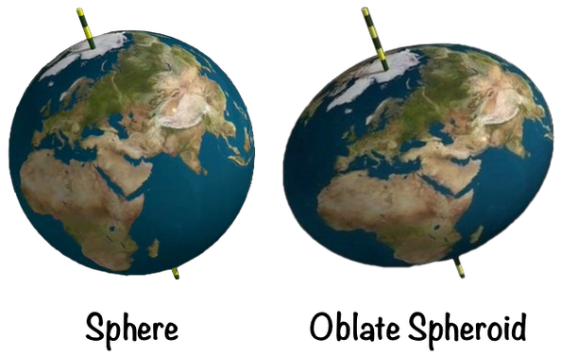
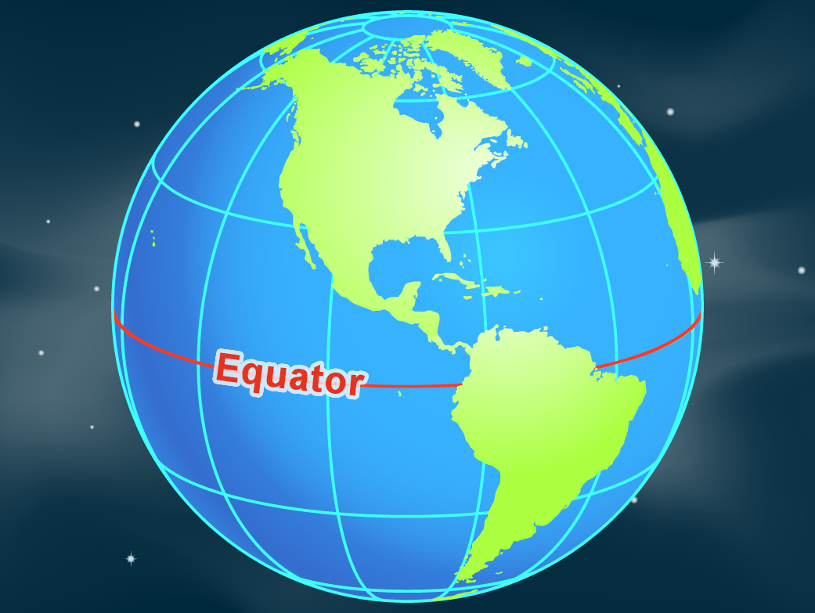
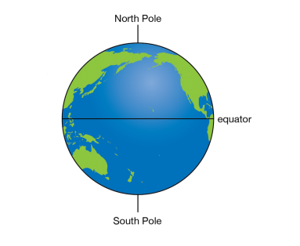
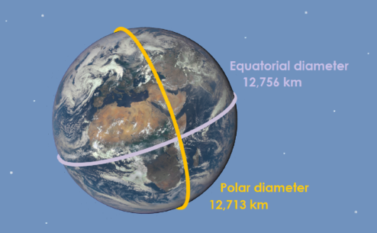
oblate spheroid: Equator:
Equitorial and polar diameters:
Poles:

Slide 14
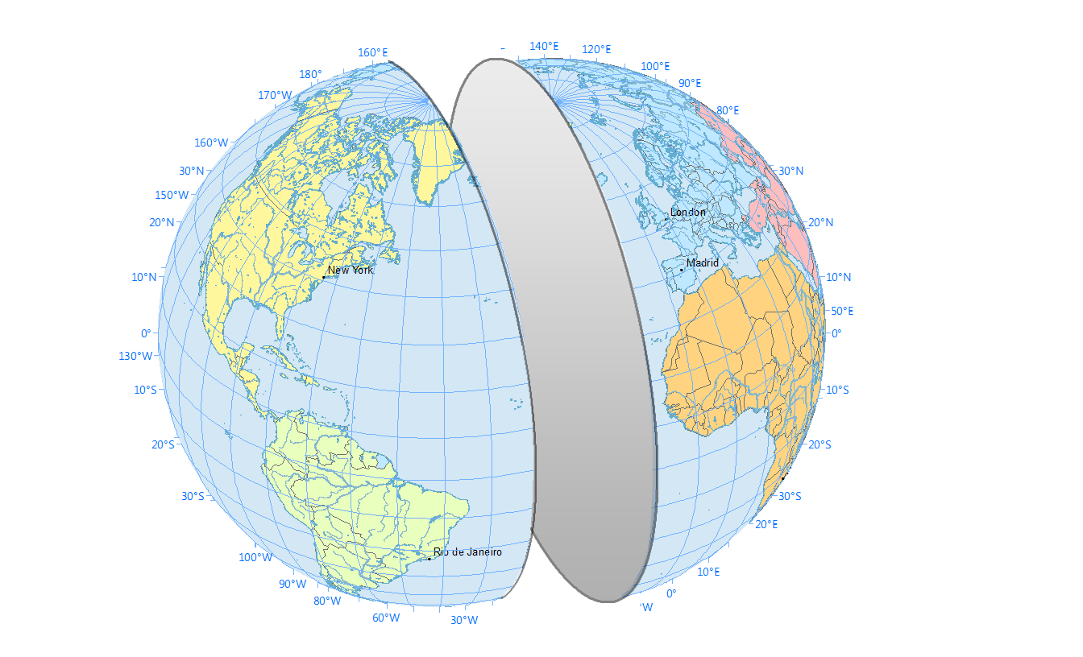
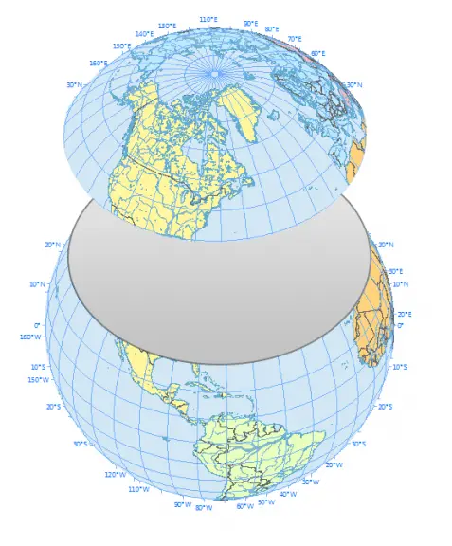
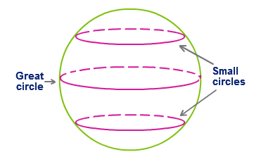
Small circle: The circle drawn on surface of the earth which cuts the earth into two parts which are unequal. The plane of the great circle always passes through the centre of the earth but small circle does not
Great circle: The circle drawn on the surface of the earth whose plane cut the earth into two equal halves
Eg: 1)The equator
2)meridians together with their anti-meridians

Slide 15
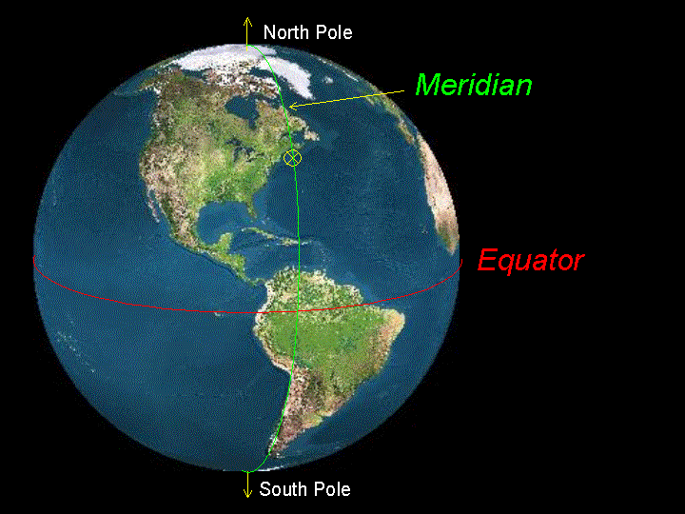
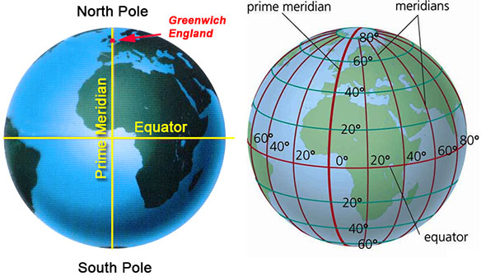
Meridian: A meridian is a half great circle joining the two poles. Every great circle joining the two poles is a meridian and its anti-meridian indicates the north-south direction
Prime meridian: The meridian passing through the Greenwich village of England which is datum for record

Slide 16
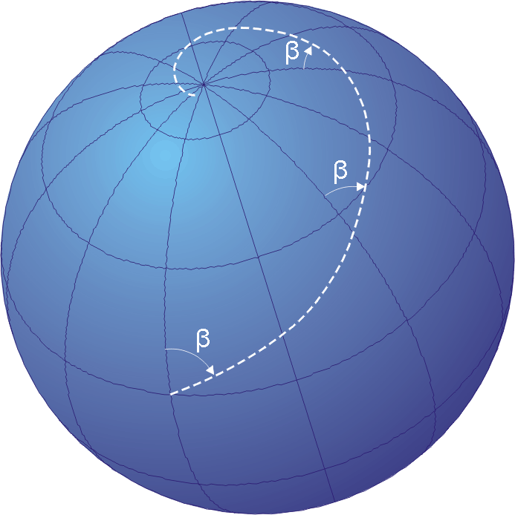
Rhumb line: The line cutting all the meridians at the same angle.
It becomes a regularly curved line
Eg: 1)Equator
Equator: It is a great circle whose plane is perpendicular to axis of rotation of earth
Equator lies in a east-west direction and divides earth into northern and southern hemisphere

Slide 17
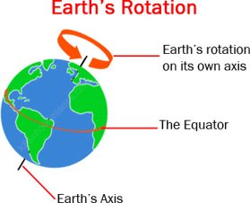
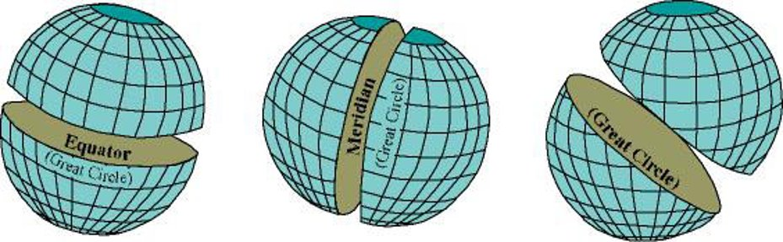
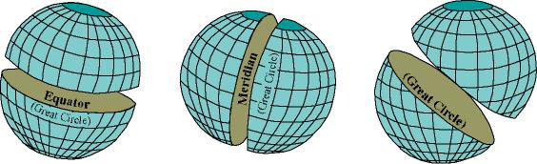
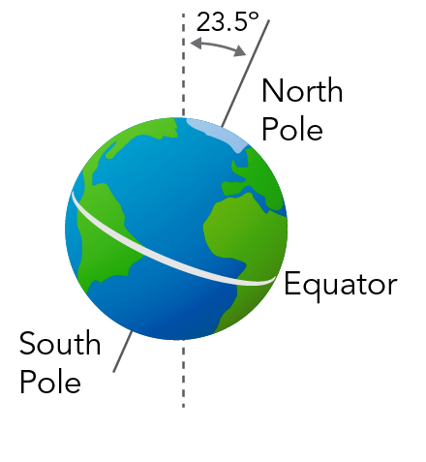
Earth Axis: It is a vertical line joining the two poles of earth,lying perpendicular to equator and passing through the centre of earth.

Slide 18
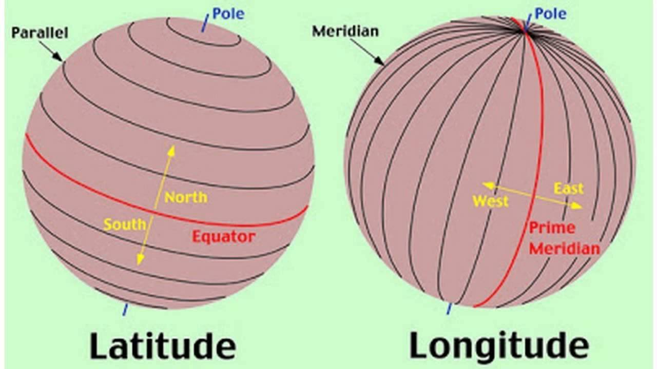
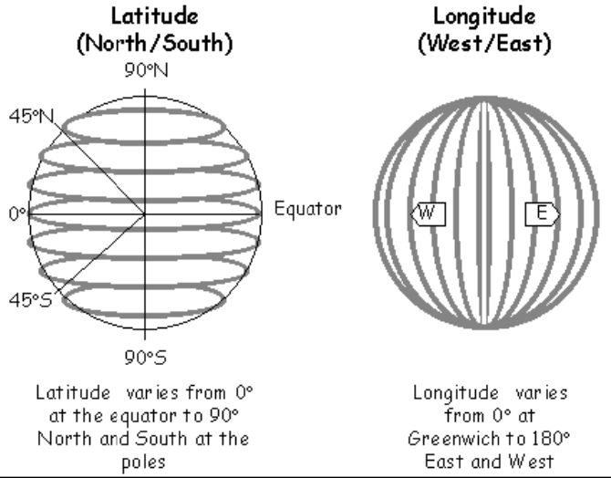
Latitude: These are the angular distances along the meridians.
The latitude is measured in degrees,minutes,seconds from (0 to 90) degrees from the equator.
Longitude: These are the angular distances along the equator on east or west of the prime meridian.
It is measured in degrees,minutes, and seconds from (0 to 180)degrees along with suffix east or west of the prime meridian.

Slide 19
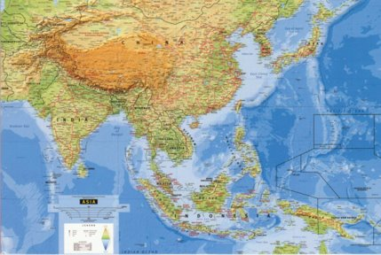
MAPS (NV-3)
Topographical map is one in which a good pictorial representation of a country is portrayed and is provided mainly to be used for map reading.
The four basic elements required in a map are:
(a) Areas will be shown correctly
(b) Bearing measurement anywhere on the reduced earth will be identical to the measurement on the earth.
(c) Shapes will be correct
(d) Distances will be measured accurately by
use of a graduated scale which is provided at
the bottom of each map.
The distances are given in
(1) Kilometers
(2) Nautical miles
(3) Statute miles

Slide 20
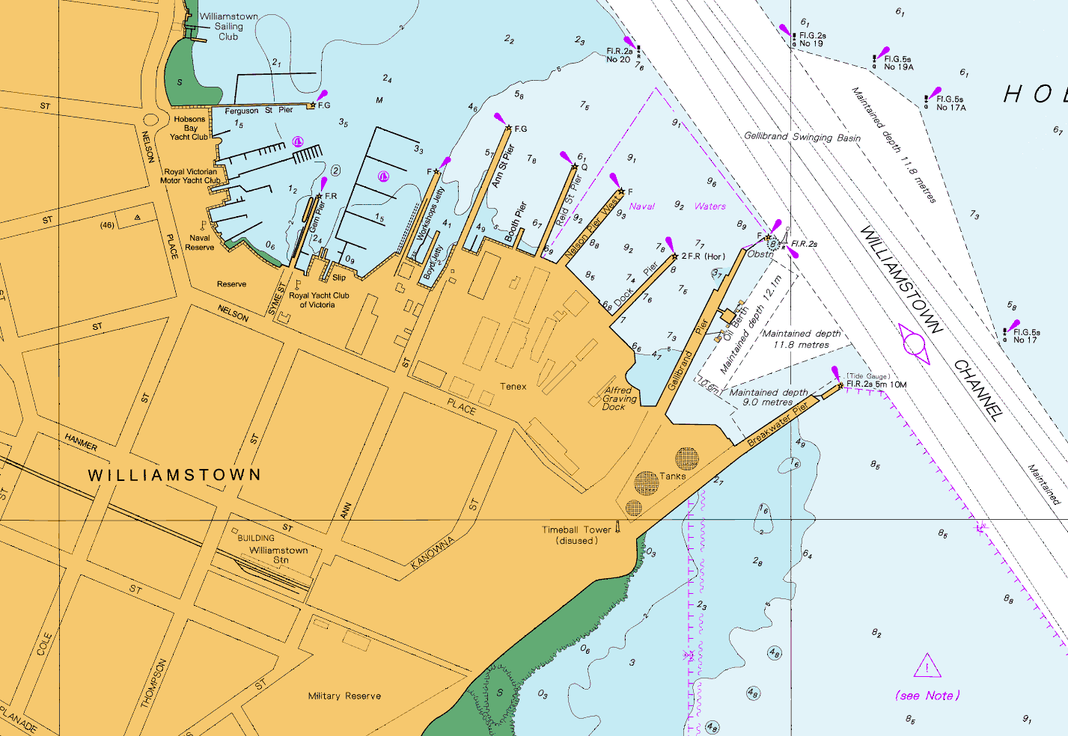
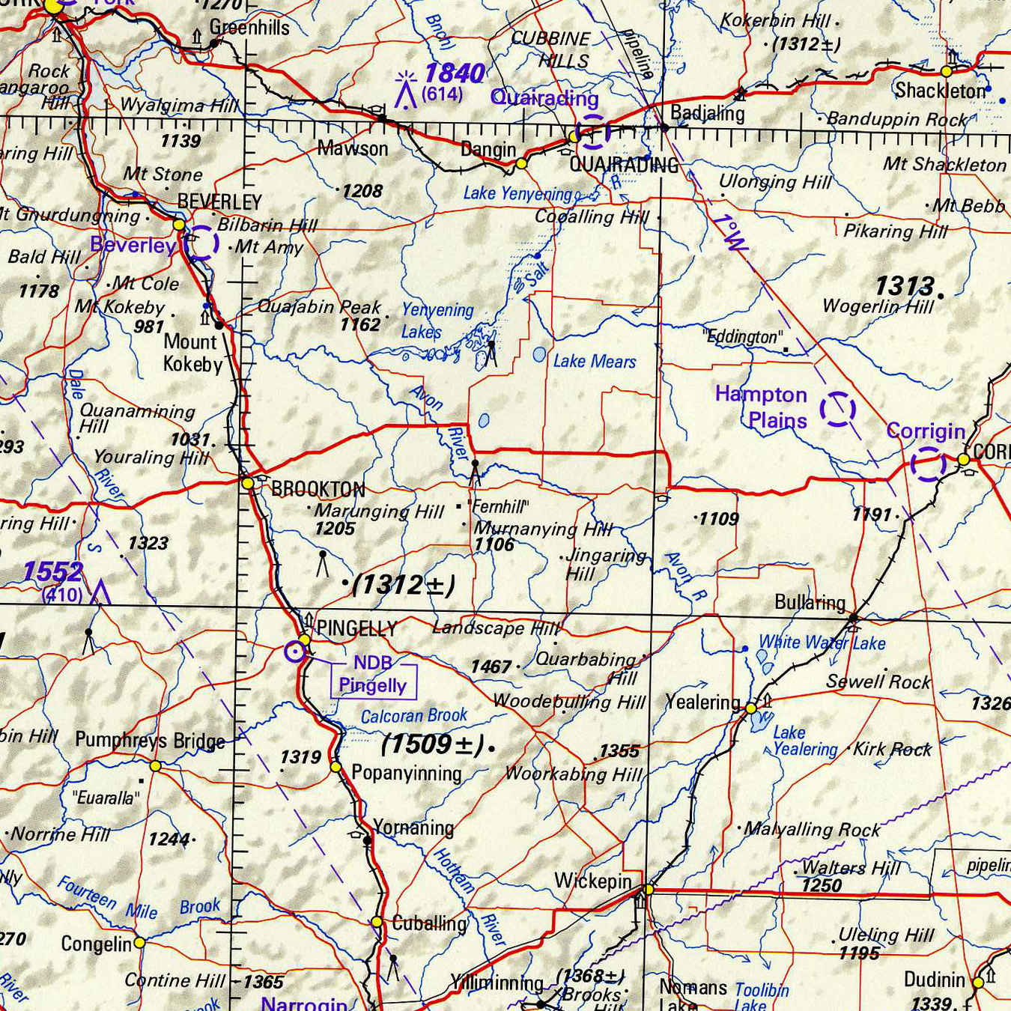
1 NM=1.852 km
1 Statute mile = 1.60934 km
1 NM=1.1507 statute miles
In aviation, both maps and charts are used for Navigation.
MAP:
When a projection has a graticule of latitudes, longitudes and an abundance of ground features it is called a map.
CHART:
A chart has a projection on which it contains
a graticule of latitude and longitude with very few
geographical features.

Slide 21
Relief:
Mountains, hills, coast lines and other natural features are of considerable interest to a pilot as they are valuable landmarks for navigation purpose or are, sometimes pose dangerous barriers for flight.
Relief is indicated on maps and charts in one or more of five different ways: (a) Spot heights or depths
(b) Contours and form lines
(c) Layer tints
(d) Hachures
(e) Hill shading
Spot Heights and Depths: These are shown against places where the exact height above sea level or depth below mean sea level has been measured.
On some maps, heights are recorded in feet. On other maps the height is recorded in meters.
One has to be very particular to note the units of heights shown on maps.

Slide 22
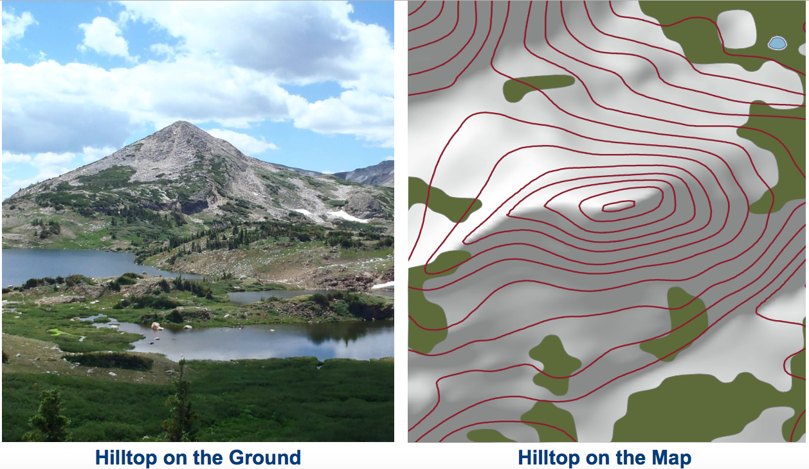
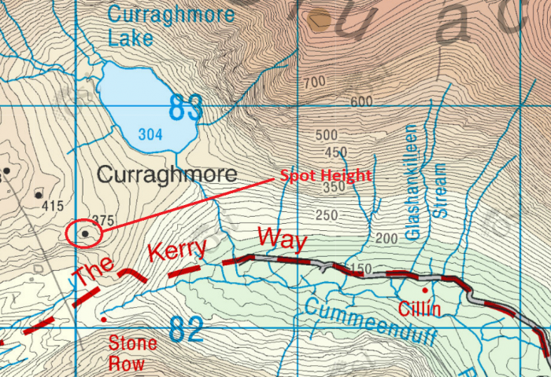
Contours and Form Lines: Contours are lines joining all places having the same heights above a certain datum level.
When these lines are shown approximately then they are known as form lines.
The closeness of the contours on a map shows the steepness of any hill.
Where the changes of height is rapid, the contours will be closer than on slopes where they are spaced.

Slide 23
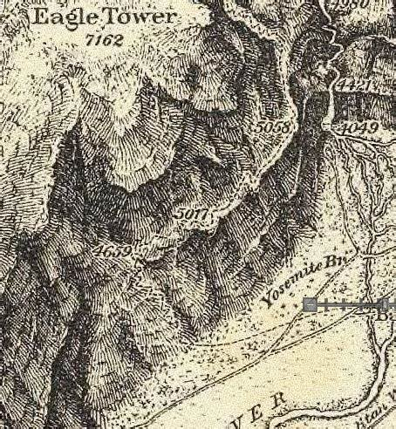
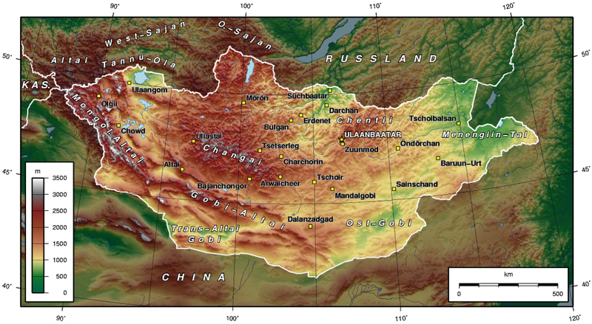
Layer Tints: These are commonly used on maps to show relief.
Layers of earth between certain contours are coloured with the tint intensifying with successive increase in height.
Thus at a glance, a map will indicate major irregularities in the surface of the country.
Hachures: These are short, tapering lines drawn on
maps and they radiate from peaks and high ground.
They only serve to show slopes.

Slide 24
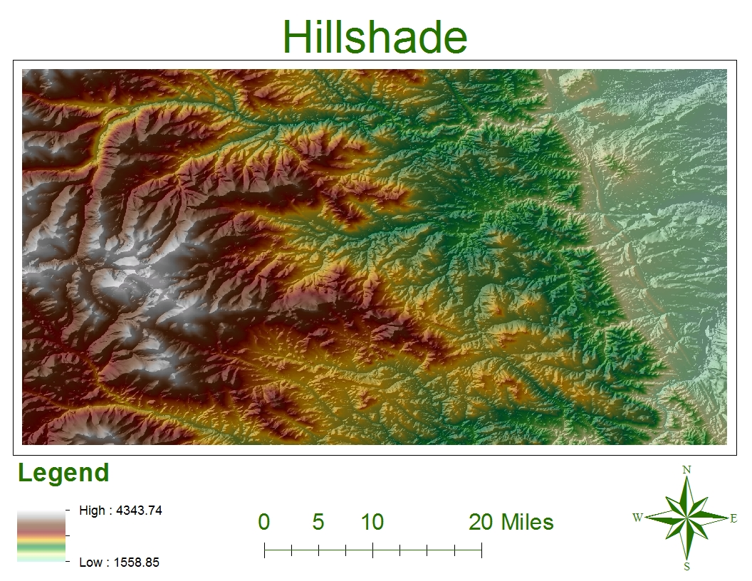
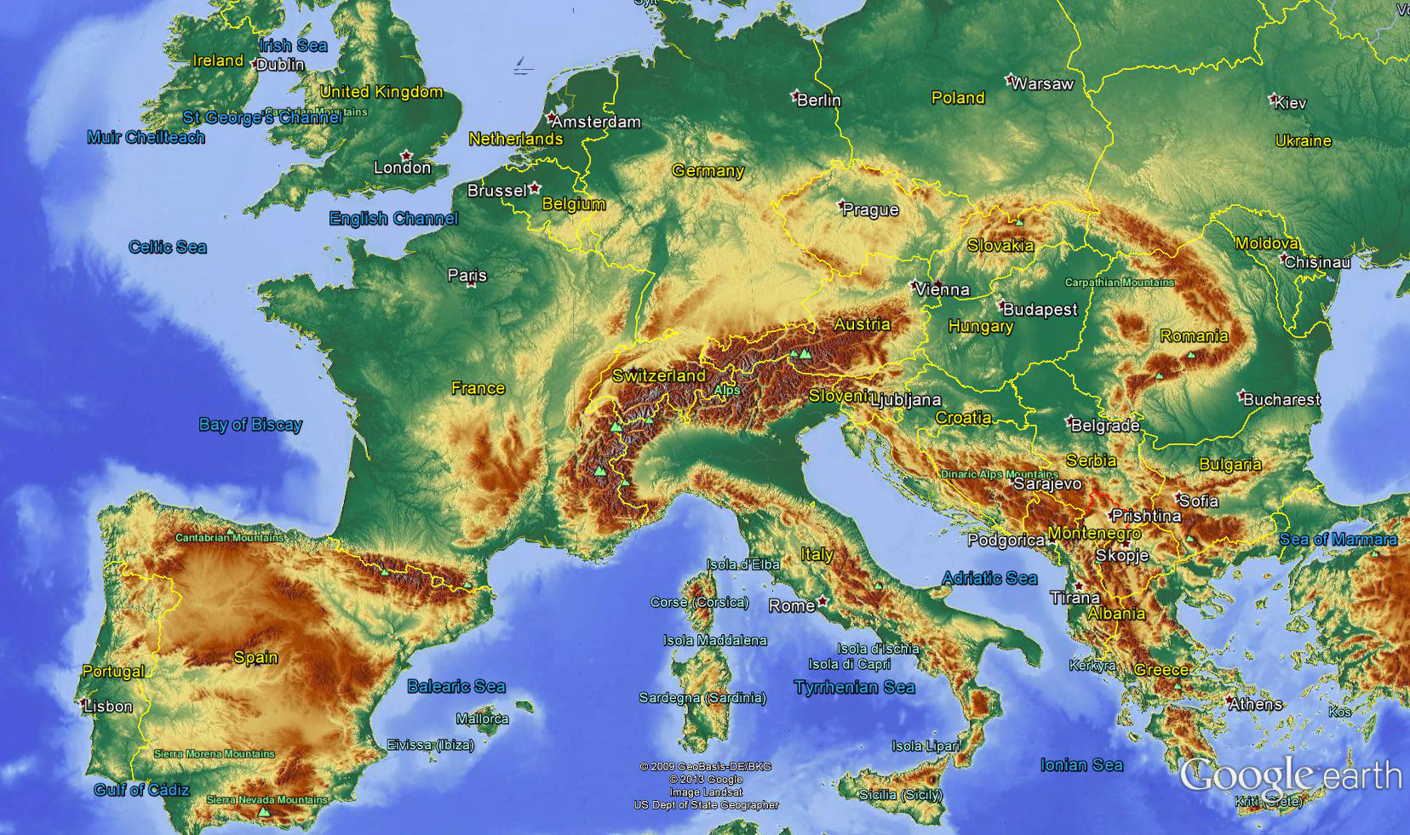
Hill Shading: This is produced by assuming that a bright light is shining across the map sheet so that shadows are cast by all high ground on its lower side.
The effect is to give the map something of a stereoscopic appearance by optical illusion.
These shadows obliterate other details on the map and are not commonly used.

Slide 25
SYMBOLS USED IN MAP:
The details on topographical maps are shown by symbols.
These symbols are used to denote the details of a map and these are called as conventional signs
All maps have a list of signs marked on the side of map and these should be studied before using the map for reading purposes.
Knowing the amount of details to be expected on maps of different scales and given knowledge of conventional signs by which that detail is indicated, the map reader is in a position to appreciate the relative value of the feature seen on the ground.
The following may help to indicate the types of which is of value to the map reader.:
(a) Coast line
(b) Water Features
(c) Mountains and hills
(d) Towns and Villages
(e) Railways
(f) Roads
(g) Wooded areas.

Slide 26
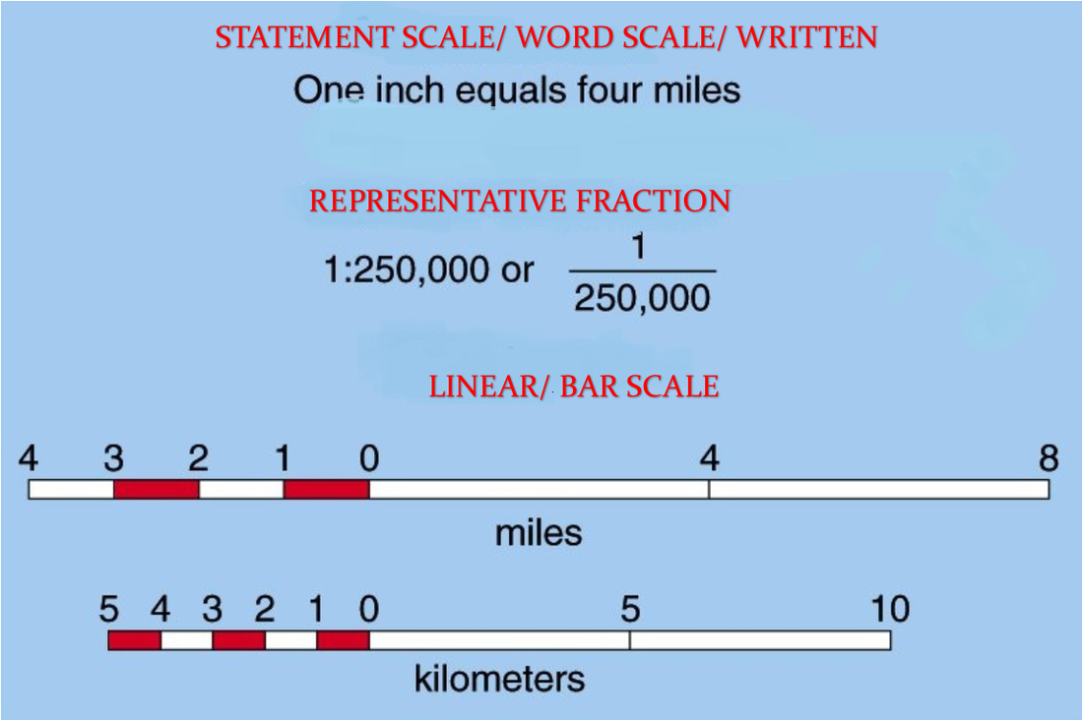
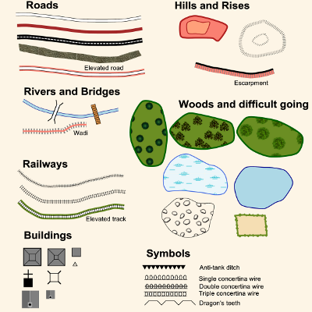
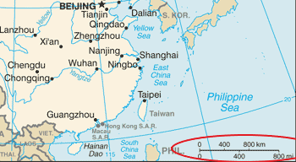
SCALES OF MAPS:
The scale is the ratio of a distance measured on the map to the corresponding distance on the earth surface.
Scales on a map is represented commonly by
(1) representative fraction
(2) graduated scale line or
(3) by statement in words.

Slide 27
MAP READING (NV-4)
Requirement for successful navigation are:-
(a) Accurate pre-flight planning
(b) Accurate flying (steering accurate courses, maintaining correct IAS, maintaining accurate height)
(c) Good map reading (without jumping to conclusions)
(d) Attention to ETA’s and change of ETA’s if necessary
Map Reading:
Fixing of position in the air by means of map reading is vital.
While many flights are made either in clouds or above clouds and during the bad visibility time, one makes a reference to the map to find out the aircraft position.
For map reading, the most important factor is ORIENTATION OF MAP or in other words, correct alignment of the map in the direction one is flying.
Good map reading is attained by constant practice.

Slide 28
Attention to ETAS:
Anticipation of features help the Pilot Navigator to keep a check on time. When ground speed is known, time to main features can be calculated in advance and marked on the map.
A good check on ground speed will automatically ensure correct ETA at destination.
GROUND FEATURES:
Map reading is always not an easy job.
No map can look precisely like the earth itself.
Symbols are used to represent ground features and the selection of symbols and features to show is not simple.
Cultural features and terrain features are two general types of information appear on maps.

Slide 29
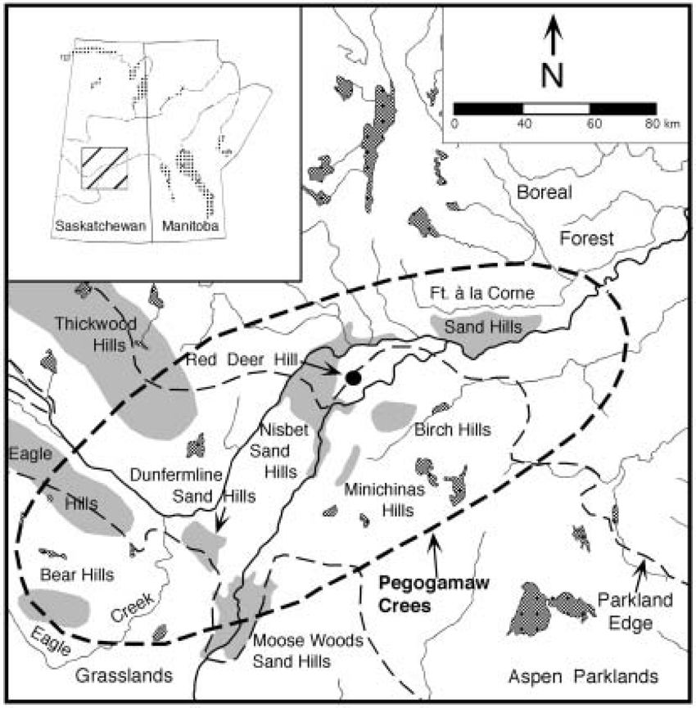
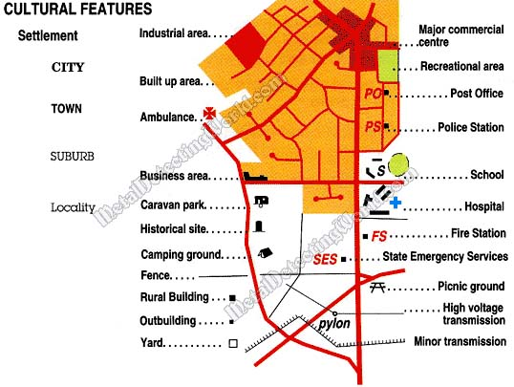
Terrain features
Cultural features
Cultural features are manmade features such as cities and towns, roads, railway, bridges, dams, race tracks, tower obstructions etc.
They are the easiest a beginner can use.
Once properly identified a cultural feature would provide a pin point fix more readily.
Terrain features are like rivers, mountain peaks, coastlines, lakes, islands etc, which provide excellent check points.
Greater skill is required to use most of this information as colour shading is used for terrain height, green colour reflecting low elevations and brown colour representing higher elevations.
Contour lines are also used to represent elevation.

Slide 30
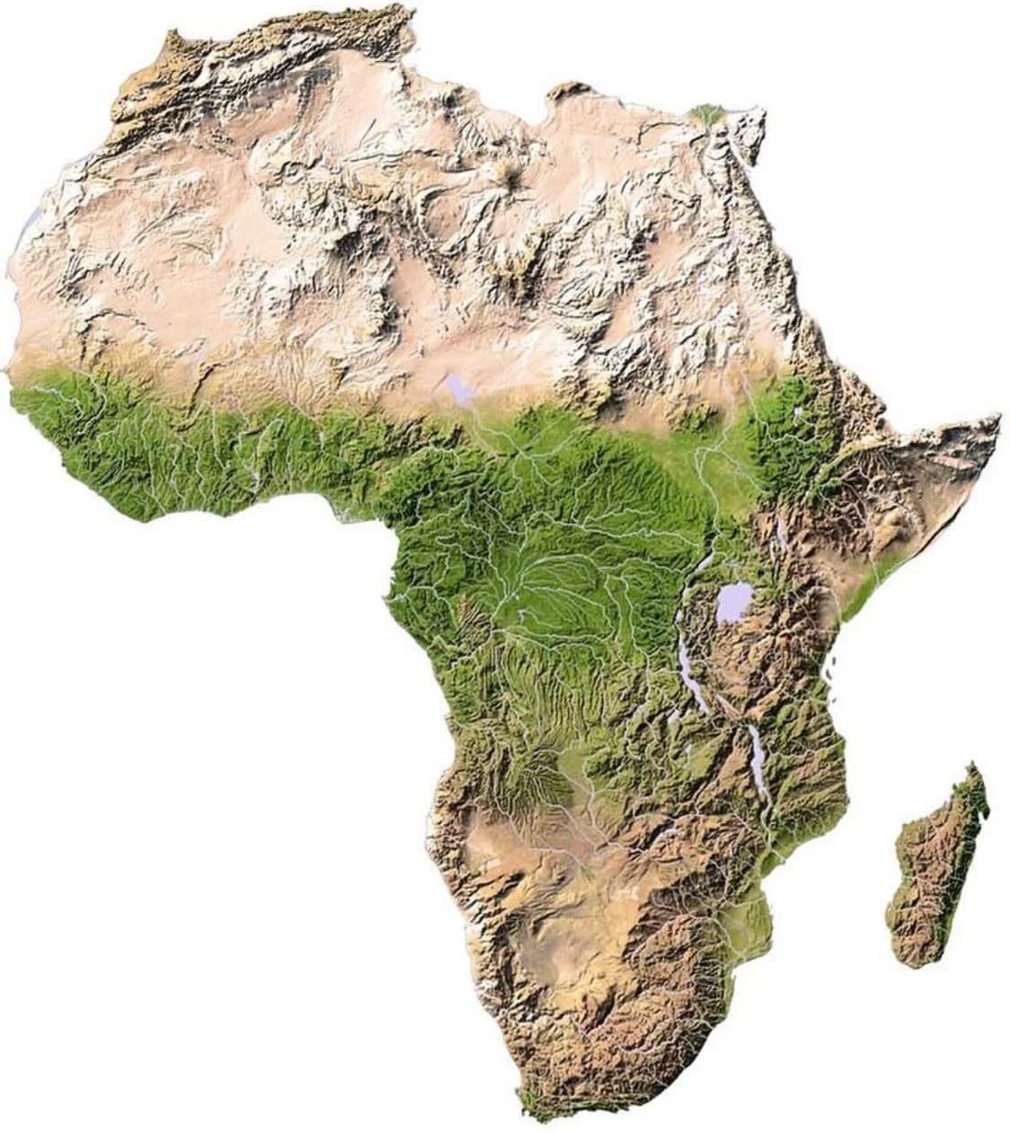
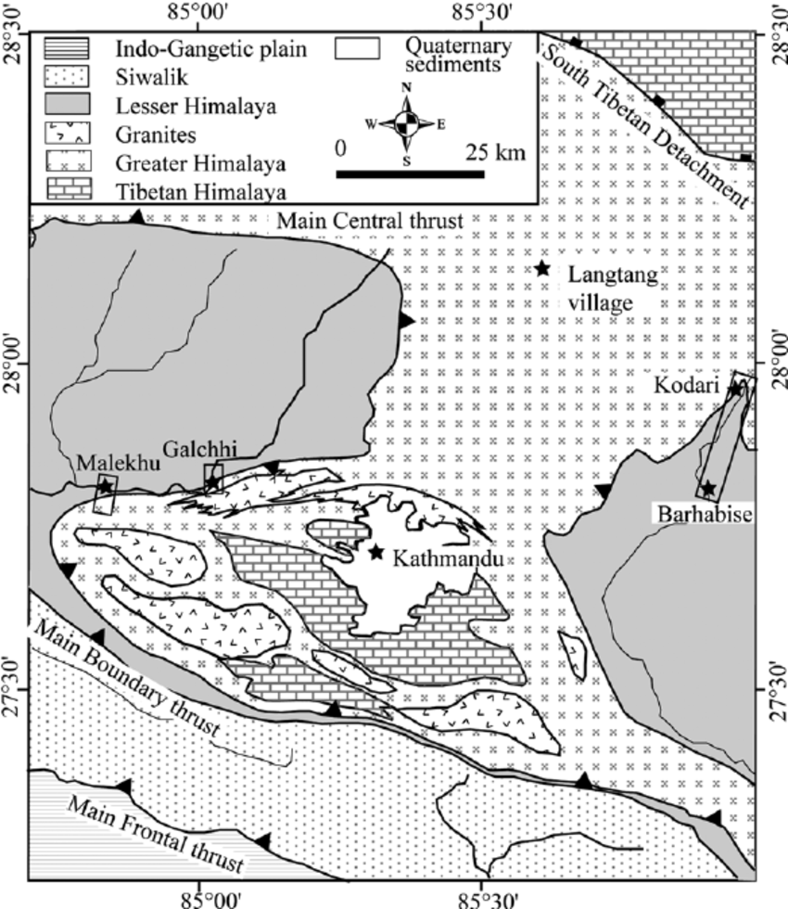
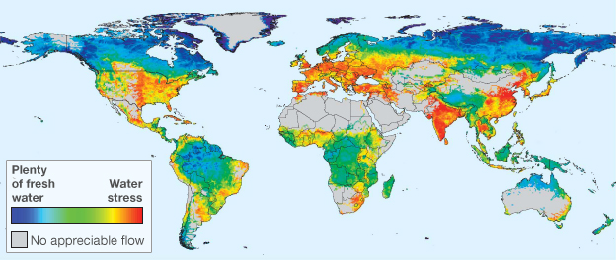
Map Reading Aids
(a) Relief-The most important signs are those indicating the height and shape of high round.
(b) Water Resources-The line separating land from water, in any form shows up more distinctly from air than does any other type of landmark. This is true not only during day light but at night as well.
(c) Hills-Usually, hills and mountains are next in importance to water features, though their value will vary with terrain. For example a peak rising 300 feet above the surrounding has little value in the Himalayas but
great value in a flat desert area.

Slide 31
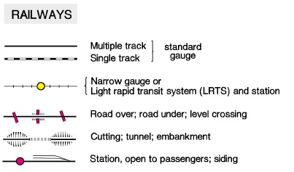
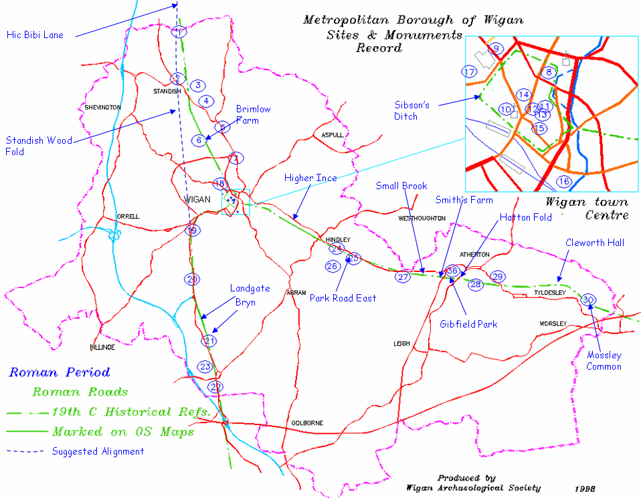
(d) Railways-Railways narrow down the position if their
bearing is known, or if the pattern is distinctive. Examples of
pattern would be long straight stretches, isolated functions, a
radical change of direction etc.
(e) Roads-Only broad arterial roads are likely to be of much of use, if they are not camouflaged by forest, sand etc.
Roads are indicated in red lines on maps.
CONCLUSION:
Map reading is an art and requires thorough practice by
student pilot.
Successful map reading depends on correct interpretation of the symbols, anticipation and accurate flying skills.
JAI HIND..!

